Slide 1
International students roommate finding.com
Start your journeys with your friends

Slide 2

Register
Email
Password

Slide 3


Personal Information
Nick name
Age
Gender
University
Level
Subject
Hometown/Province
Hobby

Slide 4
House survival guide
Rent house with students have different courses to avoid using bathrooms in rush hours.
Set a plan to clean communal areas.

Slide 5
Find friends
Select
University
Province
Female

Slide 6



Find friends
Linda
Jennifer
Lisa

Slide 7
Find friends
Personal Profile
NickName Lisa
Gender Female
Age 22
University University of Liverpool
Course name Management
Form a team
Chat

Slide 8
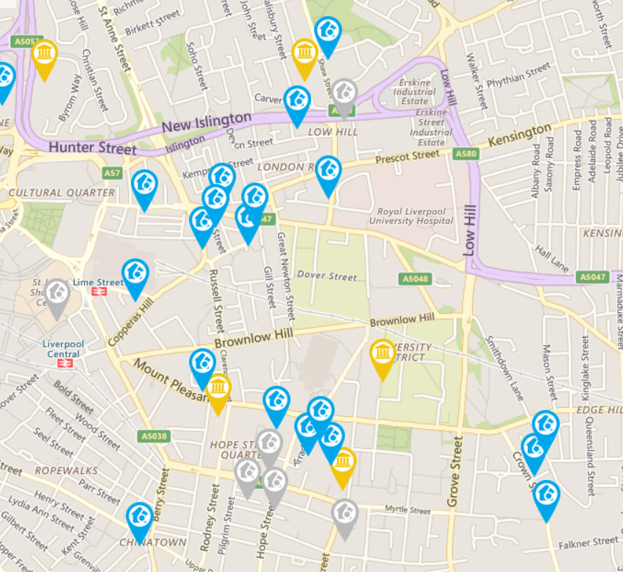
Find housemates/flatmates
Select
Main criteria
Df
Optional criteria
University
Female
Age
undergraduate
hobby

Slide 9
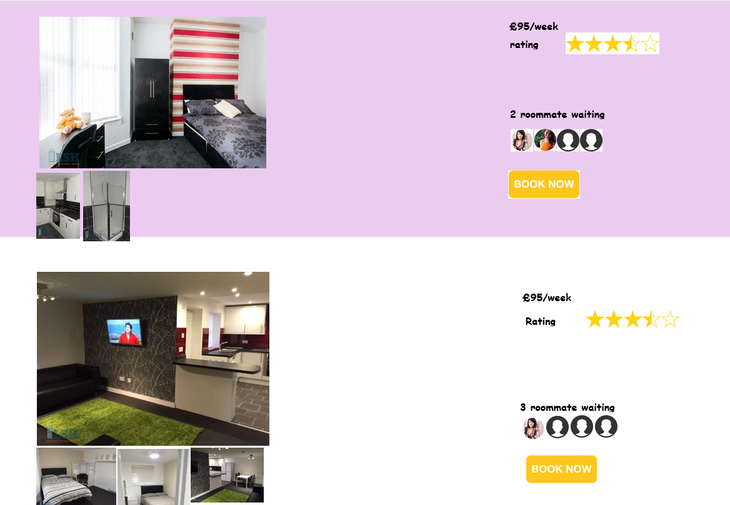
Find housemates/flatmates
If they find housemates/flatmates and they would like to live at the same place. They can book together.
If they can’t find suitable housemates/flatmates…

Slide 10
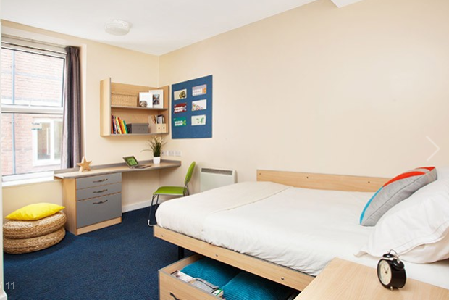


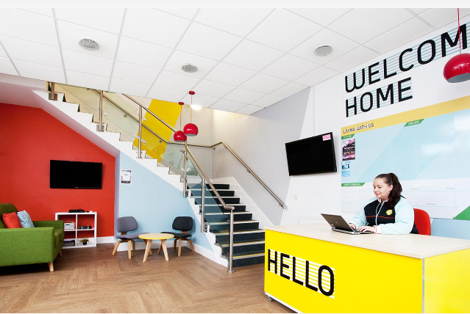
Find housemates/flatmates
Find a property that they both like
4.5
Education background, subject, years of renting
Safety
Distance
Maintenance
Service
Customer review
It is a great place to live!

Slide 11
Find housemates/flatmates
Register their interest
Define flat mates criteria
Main criteria
Optional criteria
University
Female
undergraduate
hobby
Get instant message when people ask you

Slide 12
Competitive advantages (short term)
Chinese students can find friends before they come to UK.
They can have 1-2 friends in the same house/flat with them.
They will have more choices and a safer platform to book.
They will have cheaper price for accommodation group bookings.
House landlord will have additional source of customers.
It good for Chinese students to learn English when they live with English speaking students.
Local students can benefit from learning different culture when they live with people with different culture.
Flexibility - Chinese student can find short term or rent out their current place without additional administration fee.

Slide 13
Competitive advantages (long term)
Having reliable source of houses/apartment. This can help the business to offer places for travellers who travel independently.
A communication hub with all information about students study status. It will attract more students to join as students can learn from students who previously studied in the UK.
The communication hub include each student study information in the UK. There will be business opportunities such as job hunters advertisement income.

